Slide 1


Commodity Managers : Sahil POPLI, Sibish Ragul BHARATHI, Jad ELIAS, Yiming LIU
05 December 2020

Slide 2
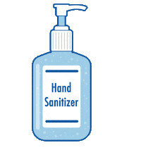

What do we expect when we go to any shop or the supermarket or any public (or even private) space ?
Do you think chemical sanitizers are safe for the skin ?

Slide 3
TABLE OF CONTENTS
1. Introduction
2. Vision statement
3. Commercial strategy
4. Sales plan
5. Purchasing strategy
6. Conclusion

Slide 4
Introduction
Specialty Chemicals Inc buys etahnol (critical catalyst) from the vendor in Texas, USA, which is the main ingredient to manufacture chemical hand sanitizers, manufactured at our 3 manufacturing facilities in Texas, USA; Antwerp, Belgium and Hubei, China.
This accounts for $100 million business for Specialty Chemicals Inc.
The Texas vendor has decided to divest from this business as they’re unable to meet the rising demands and maintain their quality. They will sell their license!

Slide 5
Introduction
An Indian company, Maruti Chemicals, is acquiring this business but moving the plant to Kerala, India.
Maruti Chemicals has interests and experience in chemical industry and natural extracts (like aloe vera) industry.

Slide 6
Introduction
Given the COVID pandemic, Specialty Chemicals Inc has decided to modify the present hand sanitizer business and manufacture skin-friendly sanitizers where along with ethanol, aloe vera would be used in the manufacturing process.
No special / new equipment would be required at our present manufacturing facilities.
Specialty Chemicals Inc will lose about 10% of the present business but skin-friendly hygiene products have a promising future. Also, Maruti Chemicals has experience in natural extracts industry which could be an advantage.

Slide 7
Vision statement
Our goal is to build trust amongst our clients and grow sales from our new product. We want to successfully corner a young market on the international level. As of now, aloe vera based sanitizers are popular in India but not so much on the international level.
To achieve this we need to build a new supply chain and a good relationship with our new vendor, Maruti Chemicals, who is based in India.
In the long term, we would like to enter the Indian market. We also look forward to cross-sell more products by diversifying our product portfolio.
Vision is where you want to be. Strategy is how you get there.​

Slide 8
COMMERCIAL STRATEGY

Slide 9
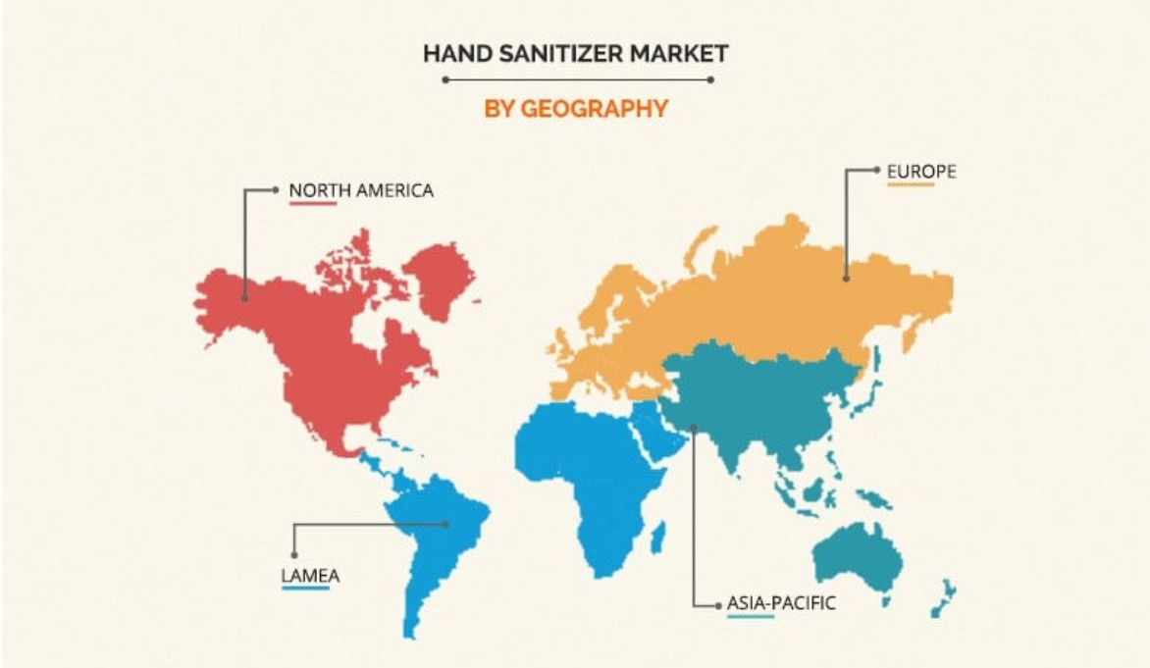

Slide 10
PRESENT SANITIZER FORMULATION – SPECIALTY CHEMICALS & OTHER COMPETITIORS
Reagents for formulation 1 | Reagents for formulation 2
* Ethanol 96% * Hydrogen peroxide 3% * Glycerol 98% * Sterile distilled water | * Isopropyl alcohol 99.8% * Hydrogen peroxide 3% * Glycerol 98% * Sterile distilled water
Overview of manufacturers using :
Reagents for formulation 1 | Reagents for formulation 2
Specialty Chemicals Inc | Dettol
Lifebuoy | Divine
RDC DRC | Meridian health

Slide 11

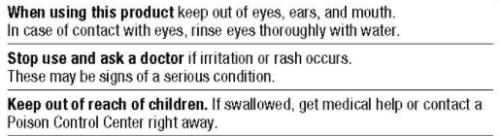
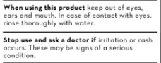
PRESENT SANITIZER FORMULATION – SPECIALTY CHEMICALS & OTHER COMPETITIORS
BUT WHY MODIFY OUR PRODUCT ?

Slide 12
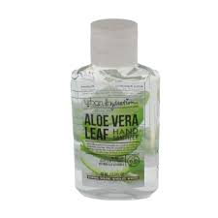
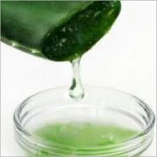
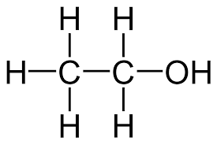


ALOE VERA HAND SANITIZER
S – Specific goal to manufacture skin friendly sanitizer
M – Measurable product risks & advantages
A – Achievable product shift & maket expansion
R – Relevant product, keeping in mind the needs of the customers
T – Strategically time bound goals
Item Qty | Ethanol 96% v/v 40% | Aloe vera extract 40% | Water 20%
Aloe vera hand sanitizer

Slide 13
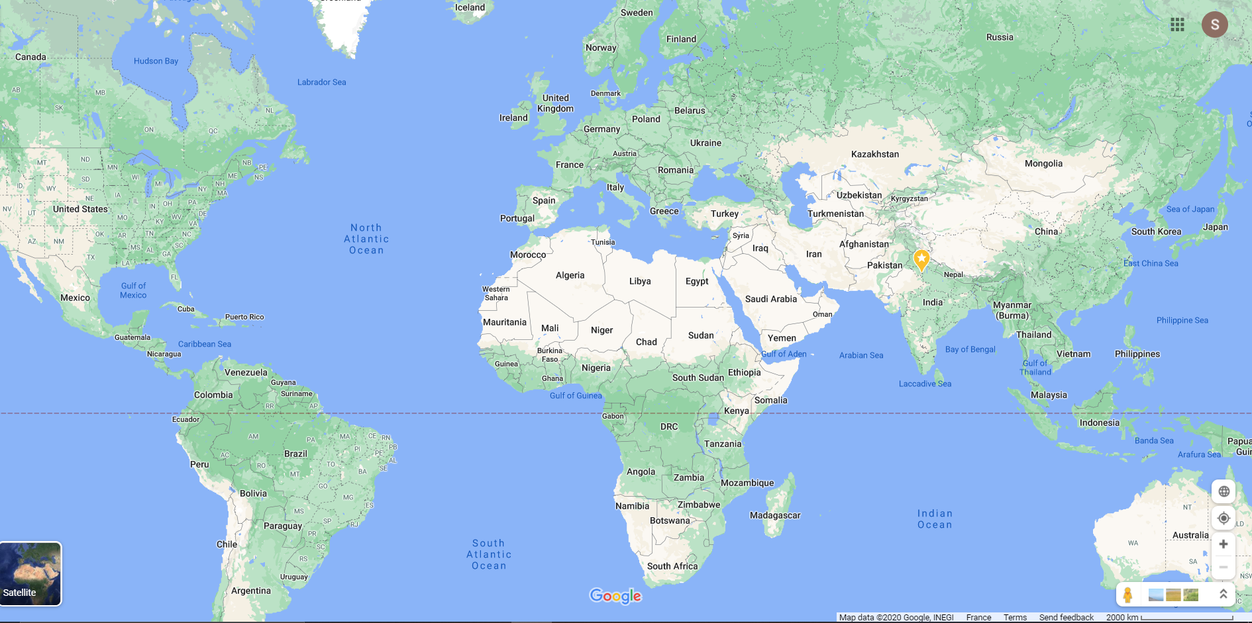



BELGIUM
HOLLAND
FRANCE
SPAIN
ITALY
UK
USA
CHINA
Manufacturing site
Vendor
Future potential

Slide 14
Shift in vendor - Advantage
Maruti Chemicals has experience in manufacturing ethanol & aloe vera extract (separately as well as a mixture based on our requirements.)
Maruti chemicals has interests in this domain and looks to expand their business
Our new vendor is based in Kerala, India, which has a tropical climate & hence, abundant supply of aloe vera.
For our manufacturing process, no new equipment is required.
Lots of potential cutomers in a presently young international market for skin sensitive sanitizers.

Slide 15
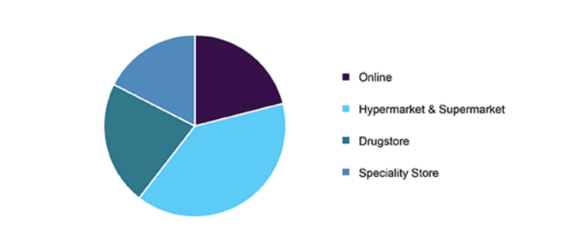
PENETRATING THE MARKET
CAGR Pre-COVID | CAGR Post-COVID
22.7% | 24.2%
Market size (pre covid) | Market size (post covid)
$ 3072.1 million | $ 3181.1 million
Based on the research data, our sales focus would be on supermarkets followed by drugstores, speciality stores & online stores.
POS for hand sanitizers
Source: alliedmarketresearch.com

Slide 16
Commercial strategy - summary
Shift in vendor from USA to India
Develop relationship with Maruti Chem
Modification of product (aloe vera based sanitizer from alcohol based sanitizer)
Develop sales in supermarkets & other channels
Penetrate into the Indian market over the long term

Slide 17
SALES PLAN

Slide 18
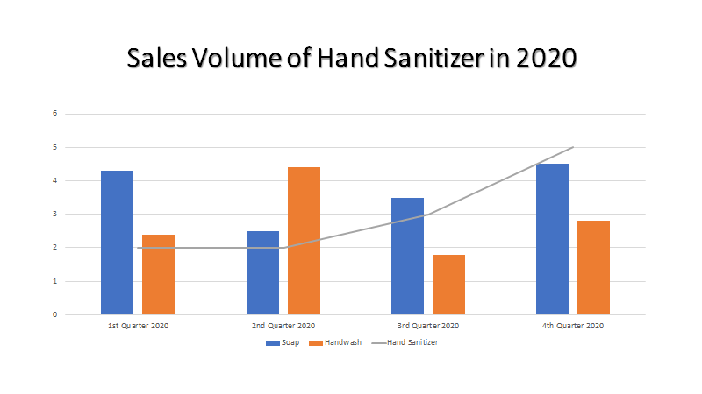

Slide 19
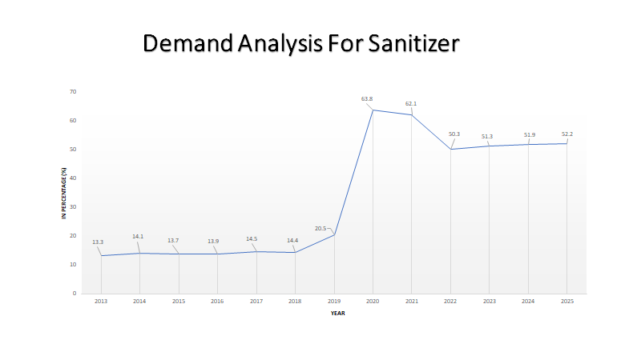

Slide 20
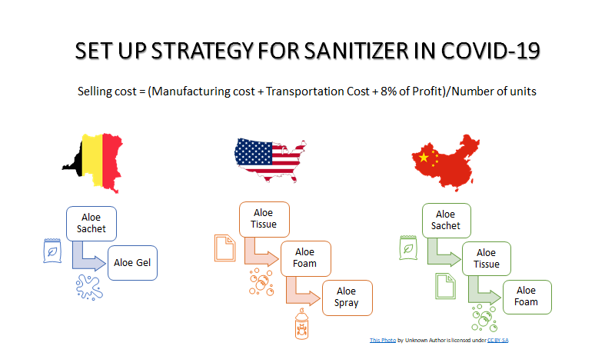

Slide 21
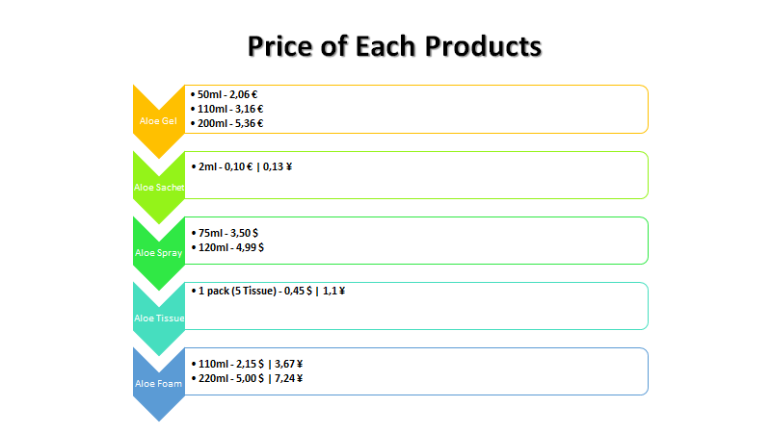

Slide 22
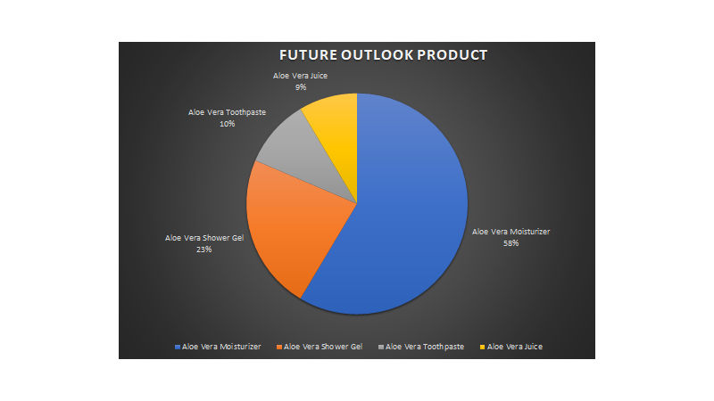

Slide 23
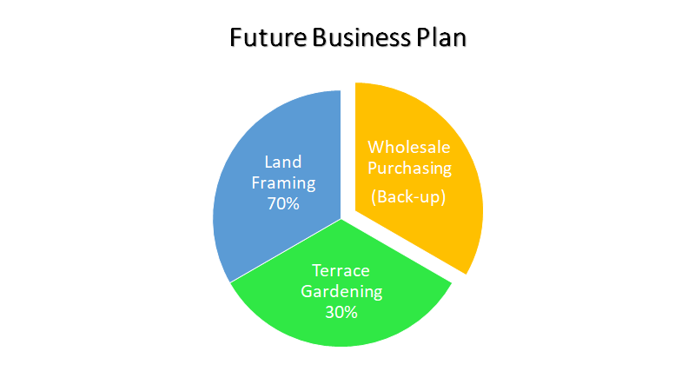

Slide 24





What we look to achieve?
No1
supplier
Global
growth
Safe
products
Diversified
portfolio

Slide 25
PURCHASING STRATEGY

Slide 26






Stakeholder engagement
Customers (over 3 continents)
Supplier (new vendor in India)
Employees (sales, q&a etc)
Without Stakeholder buy-in and support, there is no successful Category Management Plan

Slide 27
Managing the supplier shift
Order from the US vendor
Orders from US vendor & Maruti Chem
Closing of US vendor
Improve network with Maruti chem
Jan’21
March’21
June’21
Sep’21

Slide 28
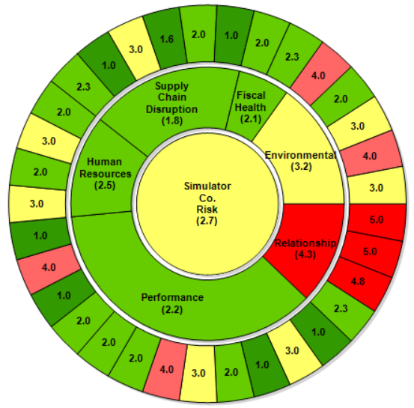
Risk analysis – Maruti Chemicals
No high risk supply chain disruption factors
Stable delivery can be expected
Bad environmental score !
Need to understand new regulations in India
Bad relationship score !
A new beginning = new relationship
Good performance score
Already popular vendor in local market

Slide 29
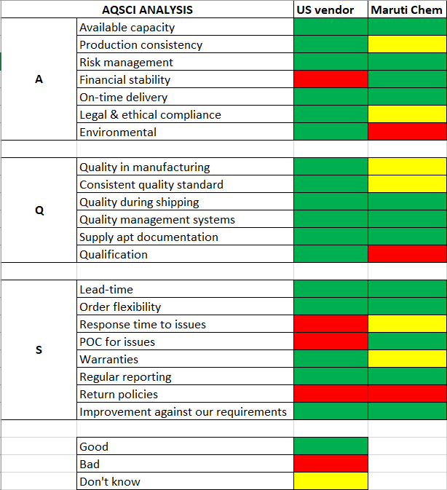




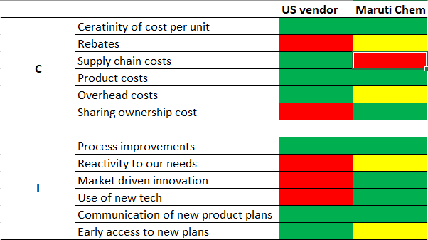

Slide 30
STRENGTH
Access to resources
Location
International network
Reputation
WEAKNESS
New supplier in new country
Complex regulatory issues
New vendor qualification
S
W
OPPORTUNITY
Niché product
New international market
Competitive price
International network
THREAT
New regulations
New laws
Return policies
O
T

Slide 31
Category Vision
Supplier Optimization
Market Winner
Green
Supply chain
Innovation
Manage supplier change successfully
Pay attention to better performance of supplier
Develop other Indian suppliers to skip from single-source
own larger market share and higher customer satisfaction
Optimize supply chain and find solutions to achieve green level and environmental protection
Expand in innovation of other aloevera product

Slide 32
Short-term plan
Mid-term plan
Long-term plan
Manage Supplier Change successfully
Build good relationship during transition
(single source）
Supplier Optimization
Volume Leveraging to better pricing and terms
Develop other Indian suppliers to get alternatives
Focused Renegotiation based on KPIs analysis
Expansion in larger market share
Optimize suppliers to push them perform better
Analyze company performance comparing with competitors and make Expansion and acquisition if possible
Green Supply chain
•Lab teams work for solutions to achieve green level •Propose green innovation requirements to suppliers and negotiate to make process improvement
Innovation in other aloevera products
•Feasibility analysis
•Sourcing Aloevera Extract and required equipment

Slide 33
Project Portfolio
P1.Supplier&Product Transition
P2. Supplier Expansion & Optimization
P3. Market Expansion in other products
P4. Green
Supply chain
PROS:
Less transportation cost
Products based on Aloe vera are popular
Existing equipments and experience
PROS:
Skip from single-source
Easier to negotiation with supplier to get better performance
PROS:
Low transportation cost
Expand new market and have more profit zone
Have customer reputation from basic product
PROS:
Social responsibilities and reputation of company
Environmental contribution
May get subsidy and support from government
CONS:
Switching cost and testing cost &time
Relationship with new supplier and new regulations
Losing 10% of present business
CONS:
Uncertain suppliers efficiency
Supplier relationship management may cost more time and money
CONS:
Risk of new products future in local market
May need more equipments
More competitors
CONS:
Extra cost
Maybe changes in techonologies and supply chain

Slide 34
Project charter
Try use renewable energy sources
Reduce CO2 emission
Achieve green levels
Goal:
Social responsibilities and reputation of company
May get subsidy and support from government
Opportunity:
Transportation cause large amount CO2
Packaging leads to a lot of waste
Complicated production process causes energy consumption
Problem:
Lab teams and R&D department work on green products and packages
Renegotiation with stakeholders to make it green such as transportation
Training employees and members for green supply chain
Scope:
Team:
Purchasing manager, Production manager, HR manager, Sales manager, Finance manager, R&D manager, CEO
Timeline

Slide 35
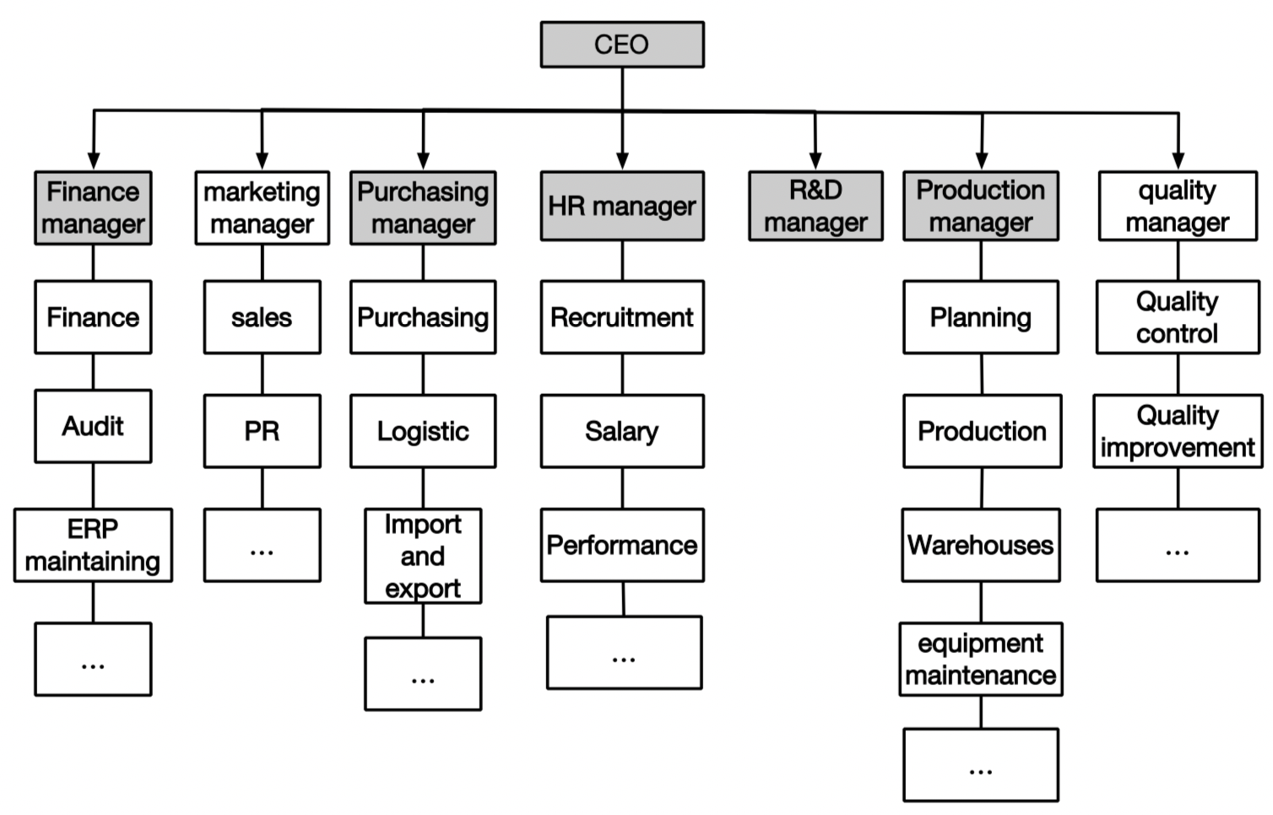
Team:

Slide 36
Timeline
JAN 2021
Replenish the inventory from the US supplier before closed.
Connect with the new India supplier(Maruti) for further cooperation
JULY 2021
Switch to new supplier and new product
2022
Supplier Expansion & Optimization
Start planning green supply chain
2024
Market Expansion in other products
2025
Achieve green supply chain

Slide 37
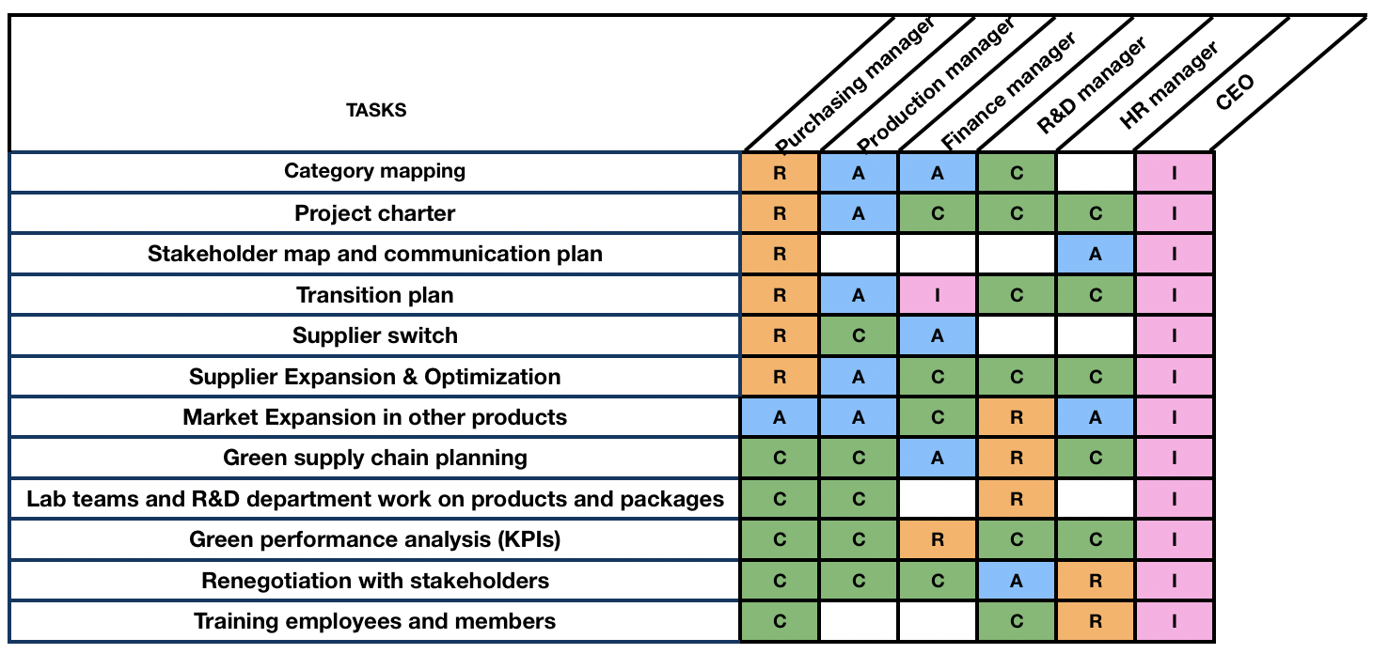
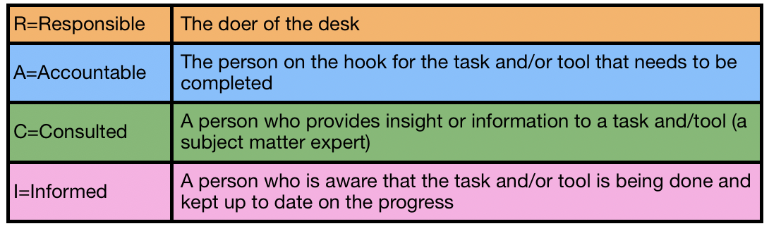
RACI chart

Slide 38
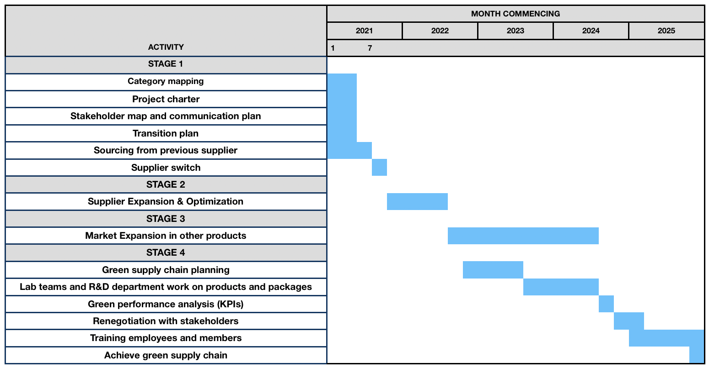
Project plan

Slide 39
Commodity Managers: Sahil POPLI
Sibish Ragul BHARATHI
Jad ELIAS
Yiming LIU
05 December 2020

